Slide 1
Weekly Update #20
Gijs Admiraal

Slide 2
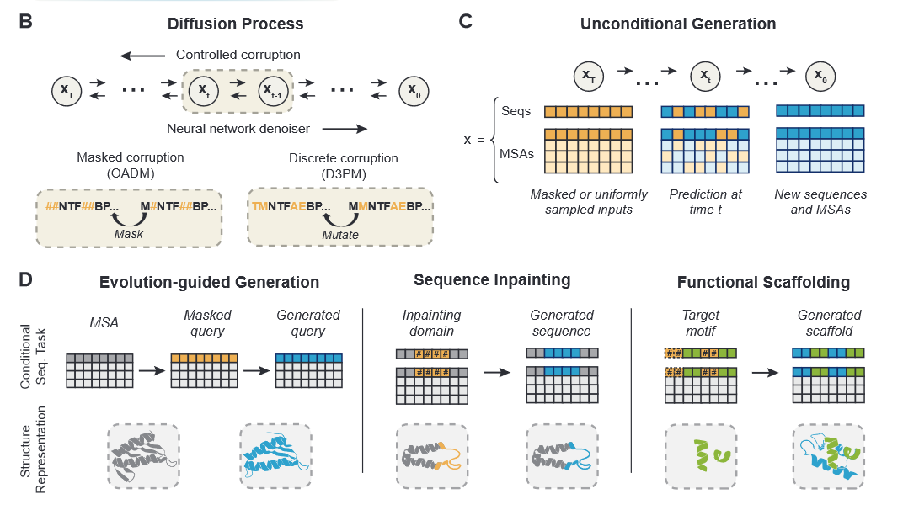
EvoDiff¹
De novo protein sequence design through discrete diffusion
Two types of generation:
Unconditional generation
Evolution-guided generation

Slide 3
EvoDiff¹
De novo protein sequence design through discrete diffusion
Two types of generation:
Unconditional generation
Evolution-guided generation
Two types of frameworks:
D3PM
With uniform and BLOSUM62 transition matrices
Order-Agnostic Auto-Regressive (OADM) diffusion model
Similar to D3PM with absorbing state transition matrices
Trained on UniRef50
Denoising model: ByteNet-style CNN architecture
38M and 640M parameters

Slide 4
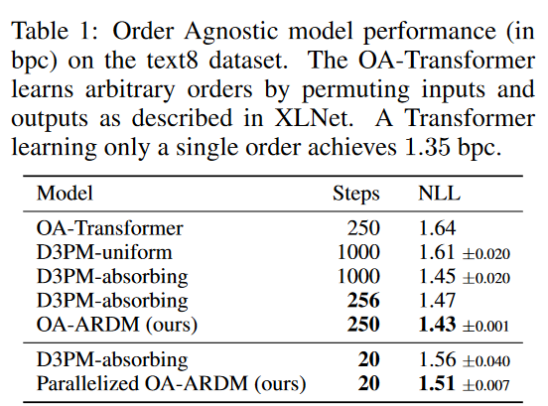
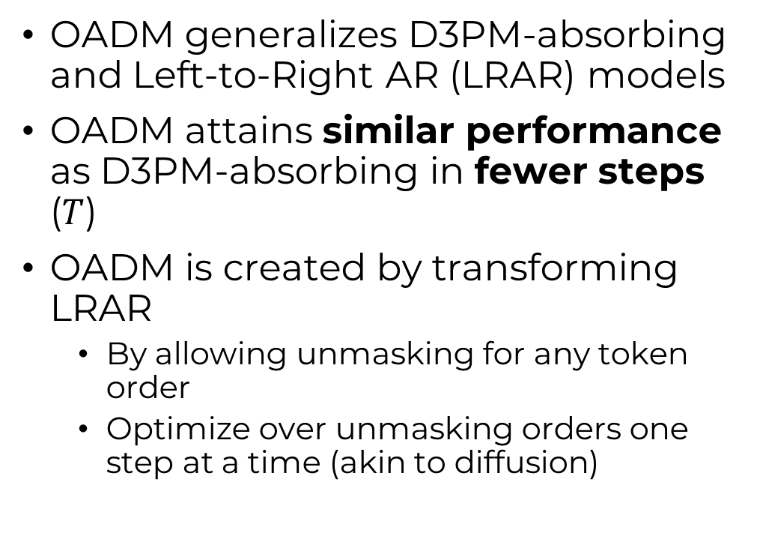
OADM vs D3PM²
OADM generalizes D3PM-absorbing and Left-to-Right AR (LRAR) models
OADM attains similar performance as D3PM-absorbing in fewer steps ($T$)
OADM is created by transforming LRAR
By allowing unmasking for any token order
Optimize over unmasking orders one step at a time (akin to diffusion)

Slide 5
ByteNet³
A 1D convolutional approach for Seq2Seq
Uses dilation to increase context window
Scales linearly with sequence length
Instead of quadratic as with transformers
“For sequences, the EvoDiff denoising model adopts a ByteNet-style CNN architecture (65) previously shown to perform similarly to transformers for protein sequence masked language modeling tasks (27).” ¹
1: Alamdari, Sarah, et al. "Protein generation with evolutionary diffusion: sequence is all you need." bioRxiv (2023): 2023-09.

Slide 6
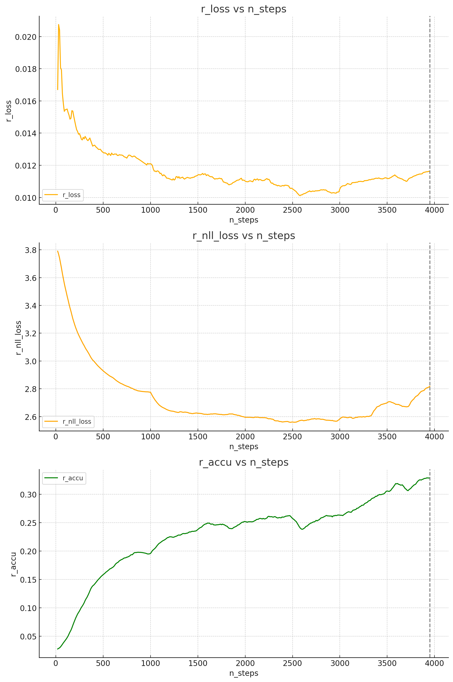
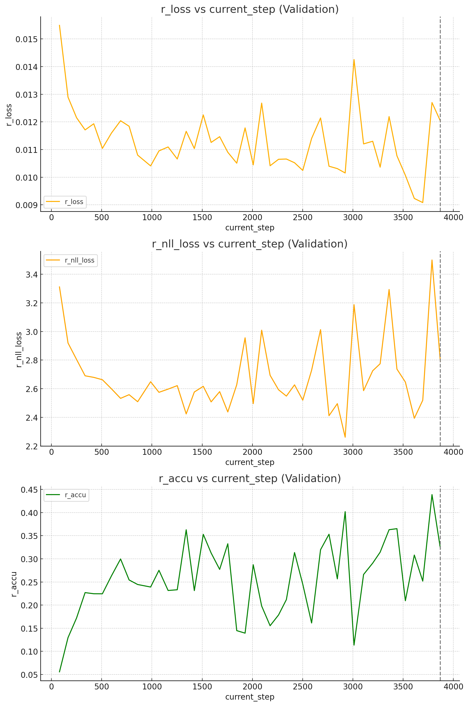
Setting up
Training
Validation
Dependency hell
Created container environment
Training: D3PM-uniform with ByteNet-38M
Metrics are regularized by number of tokens seen

Slide 7
New plan?
Use their D3PM-uniform implementation together with ByteNet
ByteNet also does seq2seq like T5
My original code problems were with T5
Skip the OADM framework
Deviates maybe too much from original plan
We keep the flexibility of D3PM framework
If there is time, allow the option to extend D3PM with absorbing state
Integrate their code with my code (or vice versa)
Comprehend their whole code base
Training on aa sequences
Training on all-atom sequences

Slide 8
Thesis update
Green light on Wednesday, October 14
Defence on Wednesday, November 27
Total thesis time: 34 weeks
Committee?

Slide 9
Notes

